Slide 1
School of thoughts
Anoosha rehan, lecturer, fast nuces cfd

Slide 2
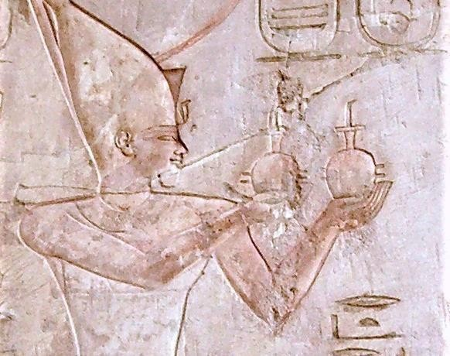
History Of Psychology
The earliest records of a psychological experiment go all the way back to the Egypt in the 7th Century B.C.
[Image: Neithsabes,CC0 Public Domain, https://goo.gl/m25gce]

Slide 3

History Of Psychology
Ancient people might have attempted to cure headaches, seizures, or psychological disorders by drilling holes in the skull. Bone growth around the hole indicates that some patients survived the procedure.

Slide 4
History Of Psychology
Greek, Father of medicine Hippocrates
Cures that Hippocrates recommended include:
rest, proper diet, exercise, fresh air and bath.
said all disorder were caused by natural
factors such as inherited, susceptibility
to disease, organic injury, and imbalance of bodily fluids.
Hippocrates (460–370 B.C.)
It was important because it was the first
widespread natural explanation for disease and so can be seen as a turning point in the history of medicine.
It led the way for natural cures and treatments. It also led to examination of lifestyle and a healthy environment.
4

Slide 5
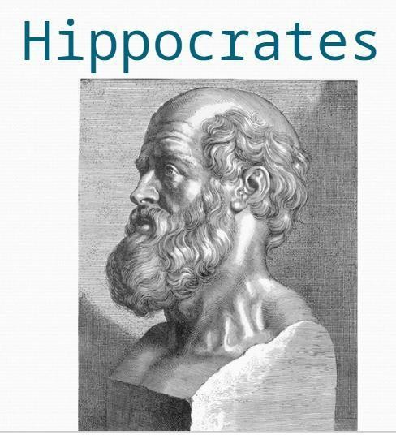
History Of Psychology
Hippocrates strongly believed that the body has the ability to heal itself and that it is the physician’s job to facilitate this natural healing.

Slide 6
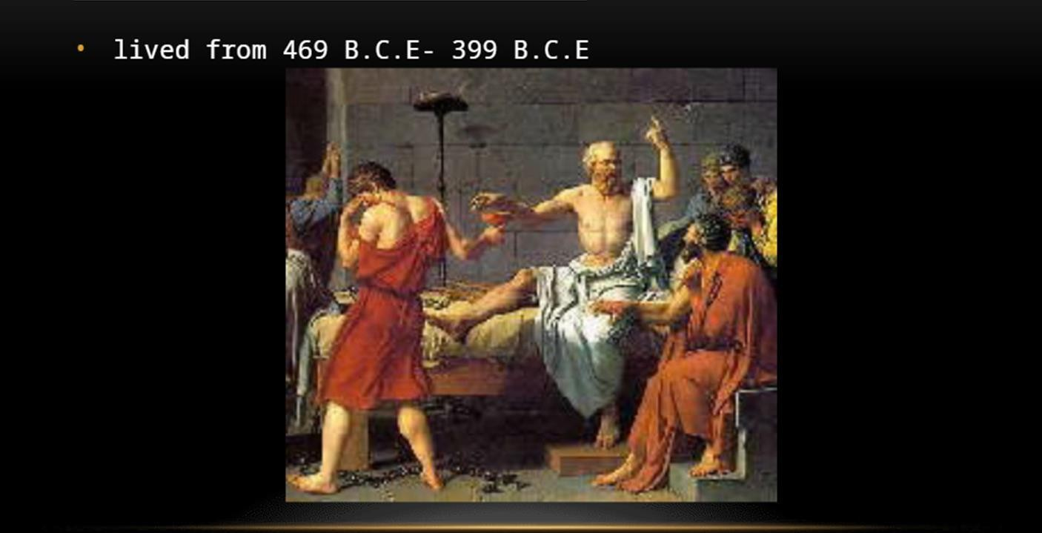
History Of Psychology
Socrates (470-399 B.C)
Individual experience is important. He took the injunction “Know thyself.” Examination of instances of such concepts as beauty, love, justice, or truth.
Virtue is unteachable
No one desires evil
No one does wrong willingly or knowingly

Slide 7
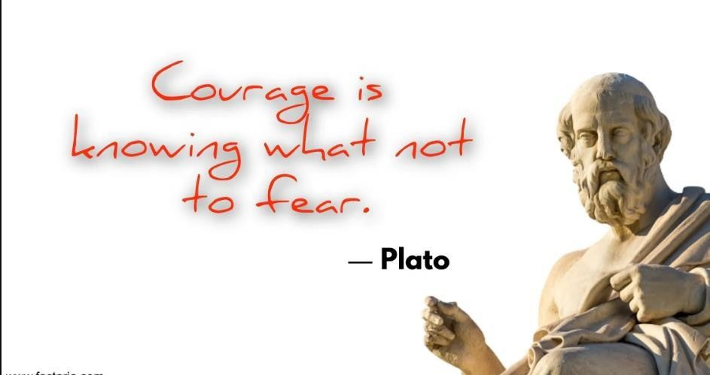
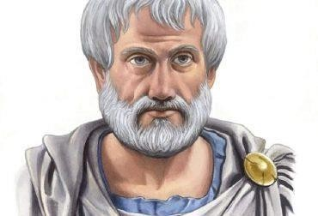
History Of Psychology
Plato (350 B.C.)
Greek philosopher that believed that who we are and what we know are innate (inborn).
Aristotle (384 – 322 B.C.)
Plato’s student believed that who we are and what we know is acquired from experience.

Slide 8
History of Psychology (Islamic Perspective)
Miraj: (Night Journey (and Ascension)
Hazrat Sulaiman (Solomon):Wisdom and Judgment
Hazrat Musa (Moses): Leadership
Imam Ali ibn Abi Talib: (Wisdom and Sayings)

Slide 9
Transition phase of psychology
From philosophy to science

Slide 10


Many psychologists when agreed on one discipline, presented a school of thought. In late 19th and 20th century, the following schools emerged:
Structuralism
Functionalism
Behaviorism
Psychoanalytic
Cognitive
Gestalt
Humanistic
Biological
Social
Evolutionary
33

Slide 11
Structuralism: Wundt & Titchener
Scientific Study of Psychology: Structuralism (ca 1832’s -1920)
Wilhelm Wundt – the father of Scientific psychology
Set up the first psychology lab in 1879 at Leipzig, Germany.
Created the approach of structuralism
Wanted to know what the structure of the mind
Aim was to study ‘building blocks of the mind’
Used introspection
“The careful, systematic self-observation of one’s own conscious experience is called introspection”

Slide 12
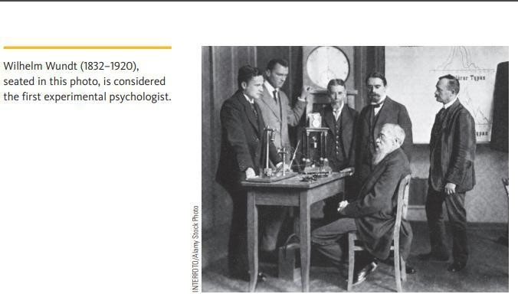
Structuralism: Wundt & Titchener

Slide 13
Structuralism: Wundt & Titchener
Studied the basic elements (structures) of thoughts and sensations (consciousness).
Felt consciousness could be broken into 3 parts:
physical sensations
feelings
images
Introspection – subject would view an object and try to reconstruct their sensations & feelings they felt while viewing it.

Slide 14
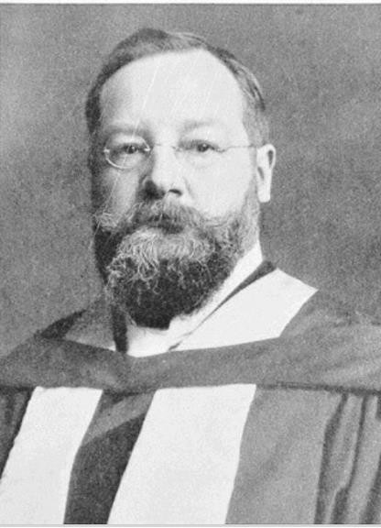
E.B. Titchener
Wundt’s student, Professor at Cornell University. Analyzed the intensity, clarity and quality of the parts of consciousness:
physical sensations,
feelings,
and images

Slide 15
Structuralism: Wundt & Titchener
Structuralism emerged through the leadership of Edward Titchener. He typically asked his subject to analyze the stimulus rather than actually giving them any object into its separate features. For example,
“What is Blue?
Blue is a color, Blue is sky, Blue is peace, Blue is cool, Blue is restful, Blue is calm…” and so on.

Slide 16
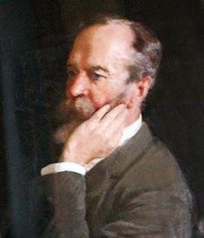
Functionalism: William James & John Dewey
First American psychologist
Started psychology at Harvard in 1870s
Opposed Wundt and Titchener’s approach
Author of the first psychology textbook (Principles of Psychology - 1,400 pages!)
Founder of Functionalism

Slide 17
Functionalism: William James & John Dewey
William James was a psychologist who felt that Wundt was asking the wrong questions. James was more interested in the function or purpose of behavioral acts. James argued that consciousness cannot be broken into elements.
Functionalists Researchers focused on how we adapt to our environments (stream of consciousness).
Main Goal was to explain human behavior.

Slide 18
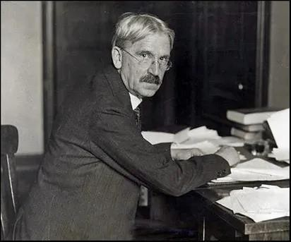
Functionalism: William James & John Dewey
John Dewey
Dewey claimed that there is a stream of behavior just as there is a stream of consciousness.
Dewey took a child touching a candle flame as an example. The analysis of such behavior in terms of reflexes claims that the child sees the flame of a candle (S) and grasps it (R). The resulting pain (S) then elicits withdrawal (R).

Slide 19
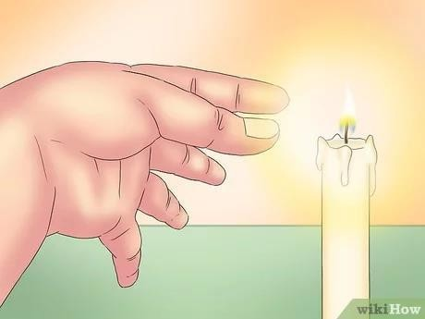
Functionalism: William James & John Dewey
John Dewey
According to this analysis, nothing changes, nothing is learned. In reality, however, the experience of being burned changes the child’s perception of the flame, and he or she will avoid it next time. This, according to Dewey, could happen only if the child was still observing the flame while being burned and withdrew. Thus, the so-called stimuli and responses are not separate but form an interrelated sequence of functional events.

Slide 20
Functionalism: William James & John Dewey
John Dewey
Indeed, for the child, the candle flame is no longer the same stimulus; it now elicits avoidance. Dewey urged that all behavior be viewed in terms of its function — to adapt the organism to its environment.

Slide 21
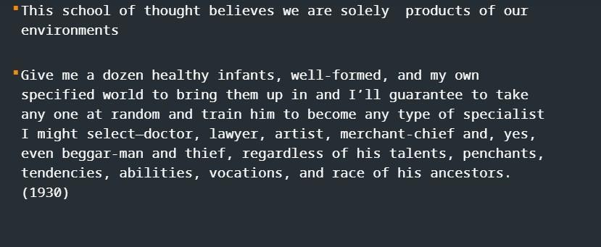
Behaviorism: Watson, Pavlov, Skinner
John B. Watson
Founder of Behaviorism. Studied only observable and objectively described acts.

Slide 22
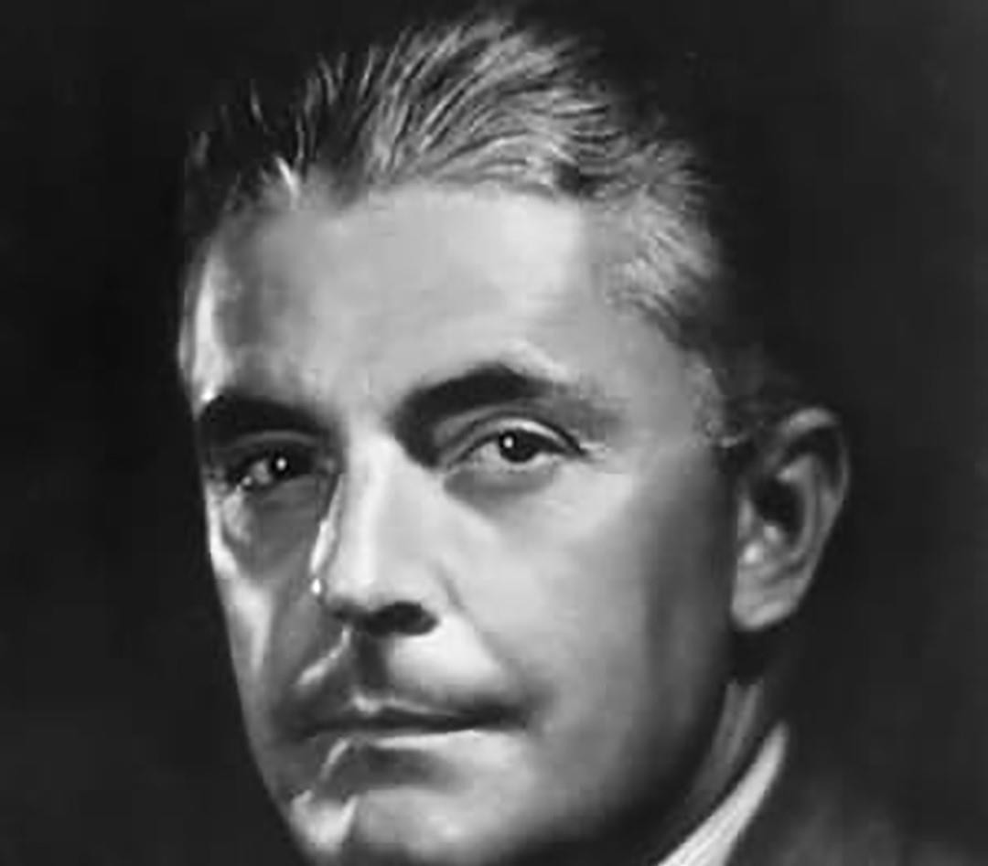
Behaviorism
Watson tried to make psychology an empirical science. He asserted that psychologists could study anything that people do or say but they could not study scientifically the thoughts, wishes, and feelings that might accompany these behaviors.

Slide 23
Behaviorism
Watson argued that each behavior is made, not born. He discounted the importance of heredity and maintained that behavior is governed entirely by the environment. He claimed that any type of behavior can be strengthened through positive Reinforcement and negative reinforcement i.e. reward and any type of behavior can be eliminated through i.e. punishment.

Slide 24
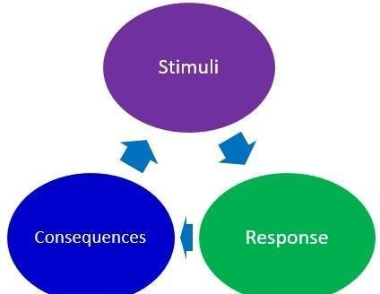
Behaviorism
Behavior refers to any overt (observable) response or activity by an organism.
R
(Response)
S
(Stimulus)

Slide 25
B.F. Skinner and Reinforcement
Like Watson, he thought that it was pointless to try and study the inner person
He expanded upon the behaviorist school of thought by adding the concept of reinforcement
Focused on learning through rewards and observation.

Slide 26
B.F. Skinner and Reinforcement
Reinforcement is the process in which a behavior is strengthened by the immediate consequence that reliably follows its occurrence. When a behavior is strengthened, it is more likely to occur again in the future.
A behavior that is strengthened through the process of reinforcement is called an operant behavior. The consequence that strengthens an operant behavior is called a reinforcer.
For example, a child cried at night when her parents put her to bed. The child’s crying was an operant behavior. The reinforcer for her crying was the parents’ attention.
Because crying at night resulted in this immediate consequence (reinforcer), the child’s crying was strengthened: She was more likely to cry at night in the future.

Slide 27
B.F. Skinner and Punishment
Punishment is the process in which a behavior is weakened by the immediate consequence that reliably follows its occurrence. When a behavior is weakened, it is less likely to occur again in the future.
A punisher (also called an aversive stimulus) is a consequence that makes a particular behavior less likely to occur in the future.

Slide 28
Reinforcement and Punishment
Reinforcement = increasing behavior
Punishment = decreasing behavior
Positive and negative reinforcement both strengthen behavior
Rule of thumb:
Positive: Increasing/Addition
Negative: Decreasing/Subtraction

Slide 29
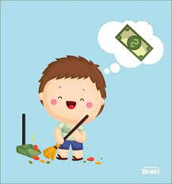
Positive reinforcement
It refers to the idea of pairing a reward or a positive stimulus with a behavior in order to increase the desired behavior.
This reward can be in any form from verbal praise to a treat appreciated by the child.
For example, if you tell your child he can play video game if he finishes homework by 8 pm. When he does it for the first time, the positive reinforcement would be the video game. This reward would increase the desired behavior of completing homework before 8 pm.

Slide 30
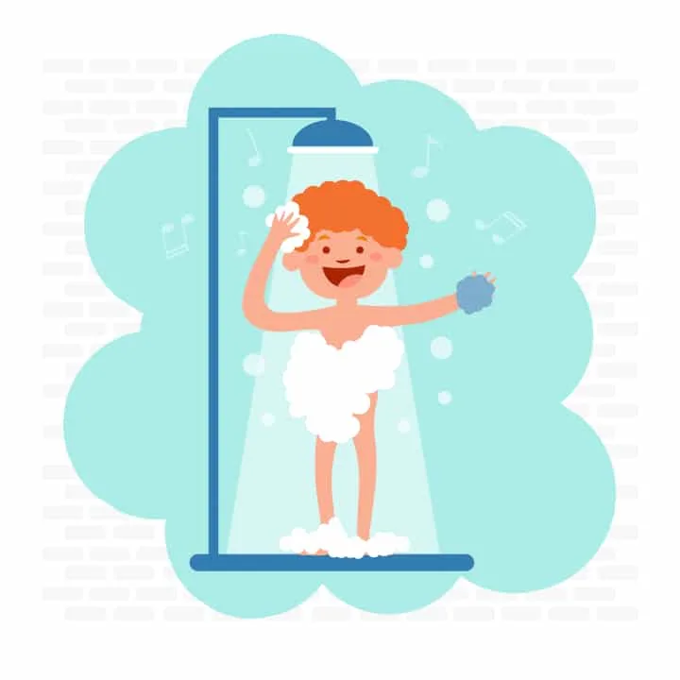
Negative reinforcement
It refers to encouraging a desired behavior by removing an adverse or unpleasant stimuli.
For example, if you are experiencing a headache and you take a medicine for that – you are subtracting the adverse stimuli of headache. Next time you experience a headache, you will most likely take the medicine again – therefore, encouragement of desired behavior occurs through negative reinforcement.
Another example of this kind of reinforcement at school can be the teacher eliminating that day’s homework if the students achieve their tasks in class.
Taking a shower can help you get rid of the adverse stimuli of being stinky.

Slide 31
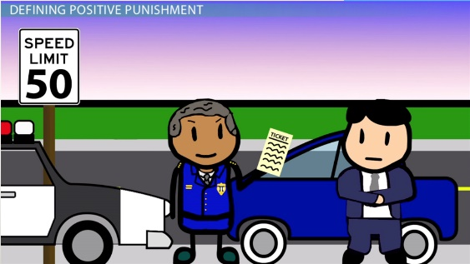
Positive punishment
Positive means “adding.” This technique is applied to eliminate the undesired behavior by adding a consequence that will discourage the child from repeating that behavior.
An example of this technique is giving the child extra homework if he did not complete his work on time. Addition of homework will weaken the behavior of incomplete work. Positive punishment also refers to the addition of a frown and scolding.
Addition of ticket for over speeding to weaken unwanted behavior.

Slide 32
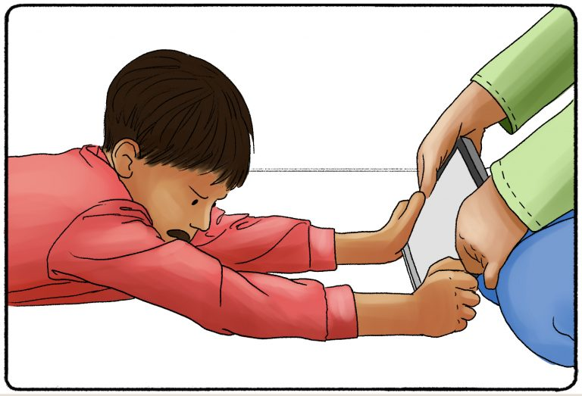
Negative punishment
It is a behavioral modification technique used to weaken the behavior by taking away a favorable stimulus such as a privilege or positive attention following that action.
Negative here refers to “subtraction.”
For example, a mother may turn off Wi-Fi at home when her child throws a tantrum. Taking away the child’s privilege, his Wi-Fi, will reduce the unwanted behavior.

Slide 33
Thank you!

